Slide 1

Modelling / Machine Learning

Slide 2

What hardcore Data Scientists do…

Slide 3
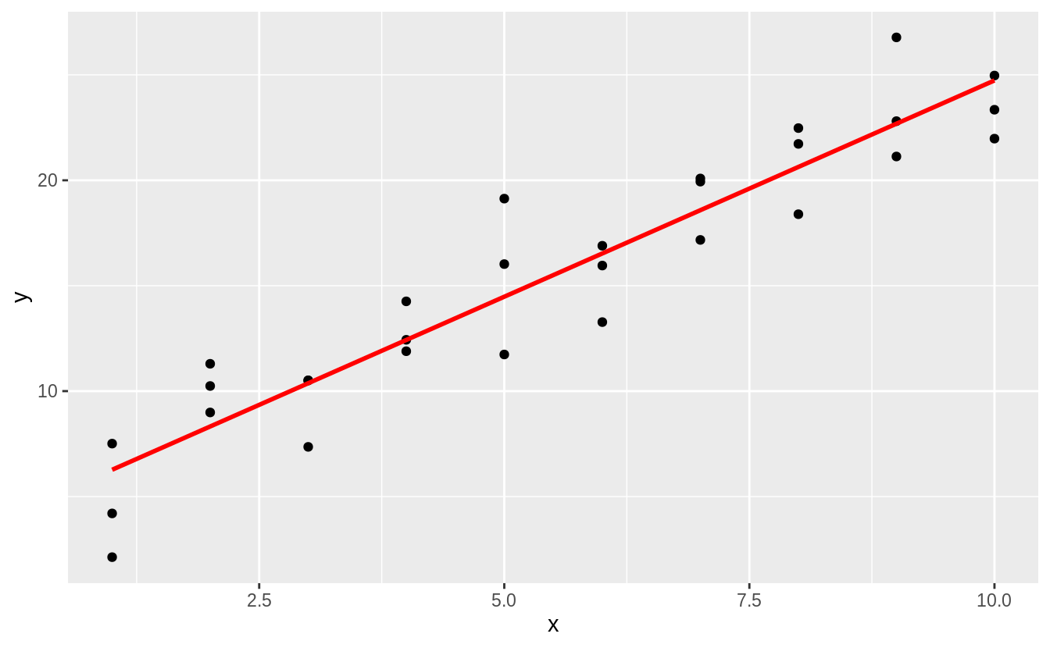
Why?
Pattern identification
Note: this doesn’t mean you don’t have to do EDA!

Slide 4
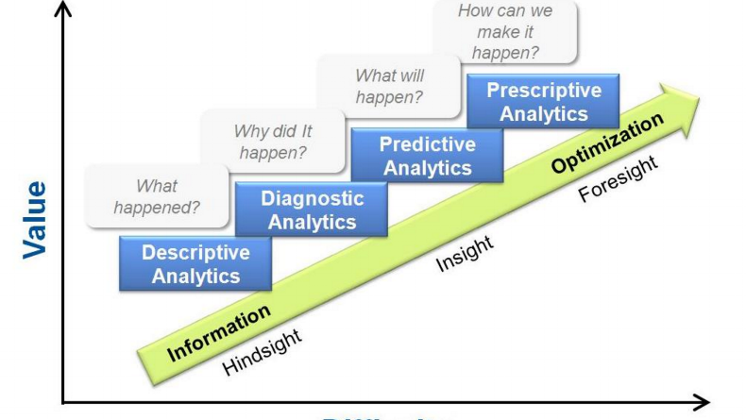
What kind of modelling
Hypothesis generation Hypothesis confirmation
/ rejection!!

Slide 5

Hypothesis generation
Want to see what’s what
Analyse the full data set and see if it matches any cool patterns

Slide 6
Linear Model
y = mx + b, where m = rise/run
m
b

Slide 7
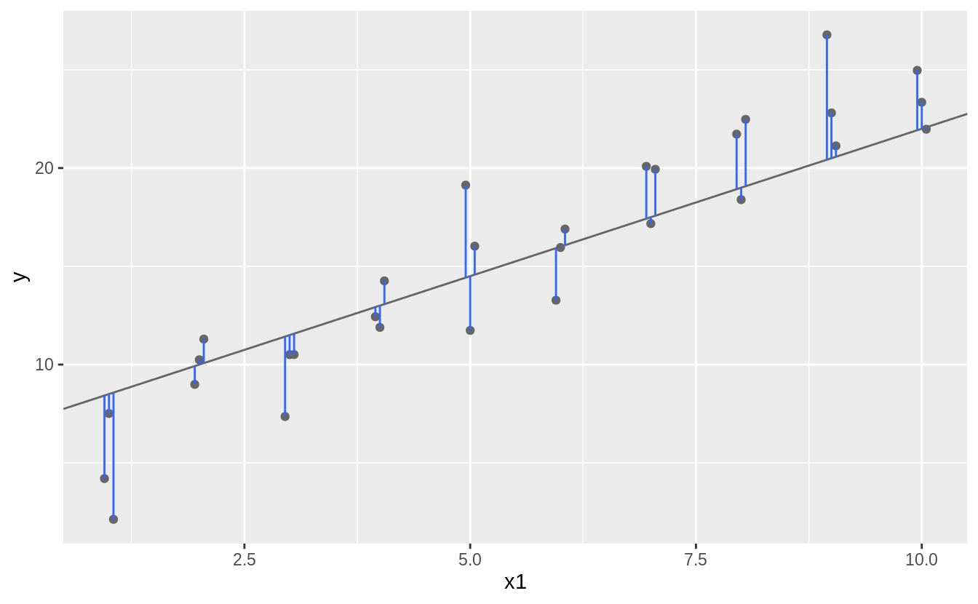

Sum of Squares: try to minimize Residuals

Slide 8
But for real tho?

Slide 9


Slide 10
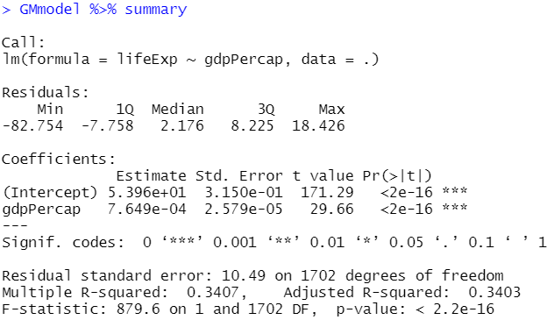
Coefficients, goodness of fit?

